Slide 1
Software Processes
A Software process is a set of activities and associated results which lead to the production of a software product.
Activities Common to all software processes:
  Software specification (initiation, requirements),
  Software design and implementation,
  Software validation (testing, QA),
  Software evolution (enhancement/maintenance)

Slide 2
Software Process Models
A software process model is an abstract representation of a software (i.e. a roadmap)
Software process models:
  Waterfall model
  Evolutionary development
  Formal systems development
  Reuse-based development
Hybrid software process models:
  Incremental development
  Spiral development

Slide 3
Waterfall model
Also referred to as “Life cycle”, conducted in five stand-alone phases:
Requirements
Software design
Code & Unit test
Integration & Testing
Maintenance

Slide 4
Waterfall model: Plus and Minuses
Advantages of the model:
  Simple to follow
  Relatively simple to track progress
  Good structural design
Challenges:
  In practice, often phases overlap
  Hard to modify and implement changes
  Need complete requirements from customers to start (the biggest challenge)

Slide 5
Evolutionary development
Develop an initial implementation, expose to users comments, refine until satisfied:
Specification
Initial version
Outline description
Intermediate versions
Development
Validation
Final version

Slide 6
Evolutionary development types
There are two types of evolutionary development:
Exploratory development
  Start with requirements that are well defined
  Add new features when customers propose new requirements
Throw-away prototyping
  Objective is to understand customer’s requirements (i.e. they often don’t know what they want, hence poor requirements to start
  Use means such as prototyping to focus on poorly understood requirements, redefine requirements as you progress

Slide 7
Evolutionary development: advantages and challenges
Advantages:
  Happier customers since you help them define requirements
  Flexibility in modifying requirements
  Prototypes are very visual, hence no ambiguities
Challenges:
  Hard to trace the “process” due to the ad-hoc nature
  Systems are often poorly structured
  Special tools and techniques may be required (for rapid development) that may be incompatible
  Not cost-effective to produce documents

Slide 8
Formal systems development
Similar to Waterfall model however development is based on formal mathematical transformation of system specification to an executable program
Software requirements specifications is refined into detailed formal specification which expressed in mathematical notion
Design, implementation and testing are replaced by a series of mathematical transformations
Require specialized expertise
usually used where safety is highly required
Not often used

Slide 9
Reuse–oriented development
Reuse-oriented approach relies on a large base of reusable software components!
Design system to capitalize on the existing components
Requirements specification
Component analysis
Requirements modification
System Validation
Development & Integration
System design with Reuse

Slide 10
Reuse–oriented: Plus and Minuses
Advantages:
  Reduced cost and risk
  Fast delivery
Challenges:
  Requires a large enough component base
  Some control over the system evolution is lost as new versions of reusable components are not under the control of organization using the component
  Potential issues in backward/forward compatibility
Notes:
Keeping track of components or who is responsible for each component is complicated.

Slide 11
Incremental development
A hybrid model where the software specification, design, implementation, and testing is broken down into a series of increments which are developed and delivered
Requirement Specification = Sum (R1, R2, R3,…)
R1
Design
Coding
Testing
R2
Design
Coding
Testing
R3
Design
Coding
Testing
Notes:
Financial market example: Release News application, then Buy/sell Funds, buy sell stocks, options, etc.

Slide 12
Incremental development:
Advantages and Challenges
Advantages:
  Products delivered incrementally hence faster
  Lower risk of overall project failure
  Requirements are implemented based on priority
Challenges:
  Relationship between different increments may be cumbersome or non-cohesive
  Size of each increment and the number of increments may cause challenges
Notes:
Incremental model: Great for larger products where time to market is very important

Slide 13
Spiral development
A hybrid model where the development of the system spirals outward from an initial outline through to the final developed system
Each loop in the spiral represents a phase of the software process
Example: the innermost loop might be concerned with system feasibility, next loop with system requirements, next loop with system design and so on.

Slide 14
Spiral development loops
Each loop in the spiral is split into four sectors:
  Object Setting: set specific object for that phase
  Risk assessment and reduction
  Development and validation: select a development model based on risk levels
  Planning: decide if a next loop is required
Notes:
3. E.g. if User interface is at risk, evolutionary prototyping may be selected. If safety is an issue, formal transformation may be selected.

Slide 15
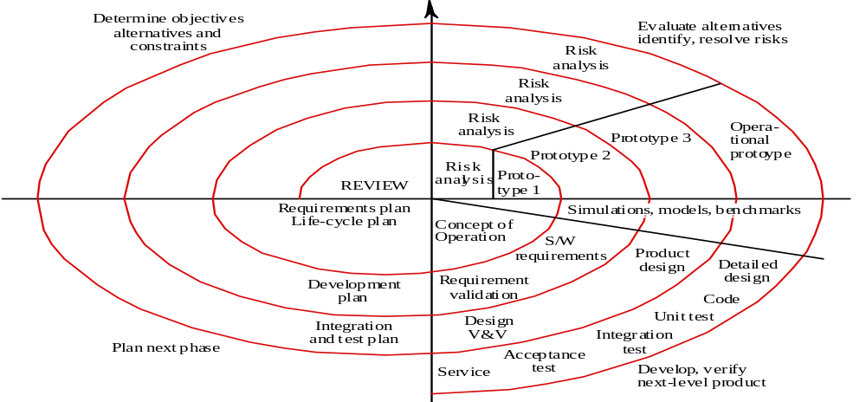
Spiral Development

Slide 16
Spiral development:
Plus & Minuses
Advantages:
  Explicit consideration of risks (alternative solutions are evaluated in each cycle)
  More detailed processes for each development phase
Disadvantages:
  Cost
  Sometime difficult to implement or too time consuming

Slide 17
Software specification activities
Feasibility study: doable? Cost-effective? Market timing appropriate?
Requirements analysis: derive requirements based on existing system, customer input, marketing information, and all other sources
Requirements specification: create formal requirements document
Requirement validation: check requirements for realism, consistency and completeness
Notes:
Vast differences between Marketing staff idea of feasibility and engineering staff idea of feasibility

Slide 18
Software design & implementation activities
Architectural design (the big picture)
Abstract specification (for each sub-system)
Interface design (with other sub-systems)
Component design
Data structure design
Algorithm design
Implementation environment selection

Slide 19
Software validation activities
Unit testing
Module testing
Sub-system testing
System testing
Acceptance testing

Slide 20
Computer-Aided Software Engineering (CASE)
CASE is the name given to software that is used to support software process activities such as requirements engineering, design, program development and testing.
CASE tools include:
  Design editors, compilers, data dictionaries, debuggers, and other system building tools…

